Slide 1
Application of TDMI on Analyzing Neural Data
Kai Chen Mar. 2018

Slide 2
Outline
Concepts and definitions
Self-information
Entropy
Mutual information(MI) and time-delayed mutual information(TDMI)
Related works about TDMI
TDMI between Gaussian random variables
TDMI between spike train and local field potential
TDMI estimation
Data generated by integrate-and-fire neuronal model

Slide 3
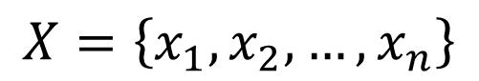
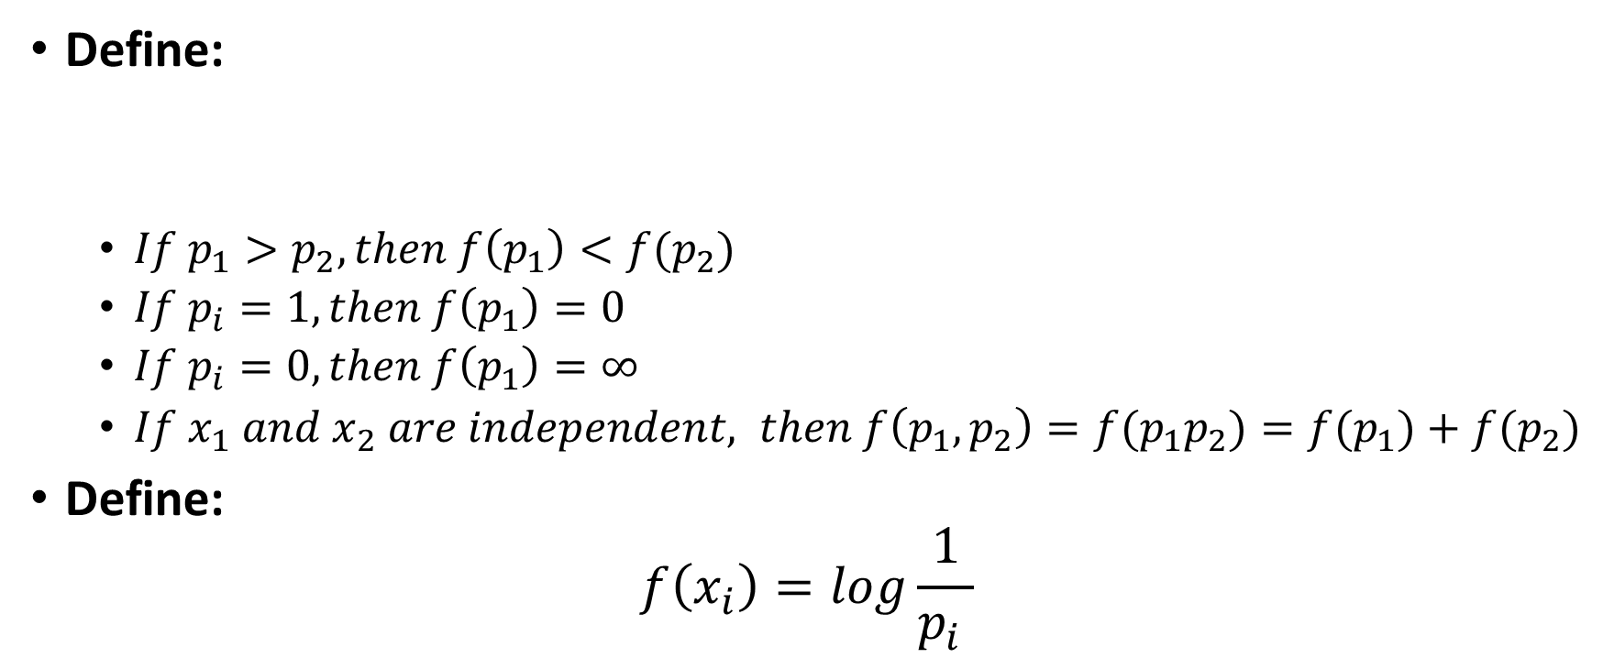
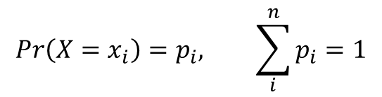
Self-information
Define:
$If p_{1}>p_{2}, then f\left(p_{1}\right)<f(p_{2})$
$If p_{i}=1, then f\left(p_{1}\right)=0$
$If p_{i}=0, then f\left(p_{1}\right)=∞$
$If x_{1} and x_{2} are independent, then f\left(p_{1}, p_{2}\right)=f(p_{1}p_{2})=f(p_{1})+f(p_{2})$
Define:
$$f\left(x_{i}\right)=log\frac{1}{p_{i} }$$
$$X=\left\{x_{1},x_{2},…,x_{n}\right\}$$
$$Pr\left(X=x_{i}\right)=p_{i}, \sum_{i}^{n}{p_{i}}=1$$

Slide 4
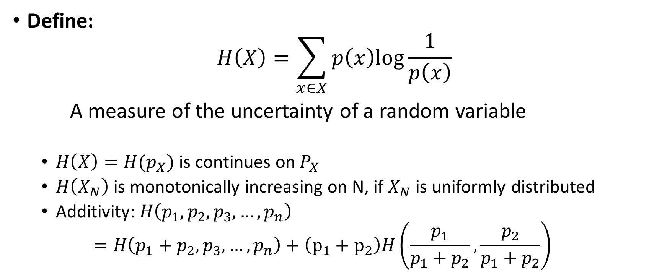
Entropy
Define:
$$H\left(X\right)=\sum_{x∈X}{p\left(x\right)log\frac{1}{p\left(x\right)}}$$
A measure of the uncertainty of a random variable
$H\left(X\right)=H(p_{X})$ is continues on $P_{X}$
$H\left(X_{N}\right)$ is monotonically increasing on N, if $X_{N}$ is uniformly distributed
Additivity: $H\left(p_{1},p_{2}, p_{3},…,p_{n}\right)$
$$=H\left(p_{1}+p_{2}, p_{3},…,p_{n}\right)+\left(p_{1}+p_{2}\right)H\left(\frac{p_{1}}{p_{1}+p_{2}},\frac{p_{2}}{p_{1}+p_{2}}\right)$$

Slide 5
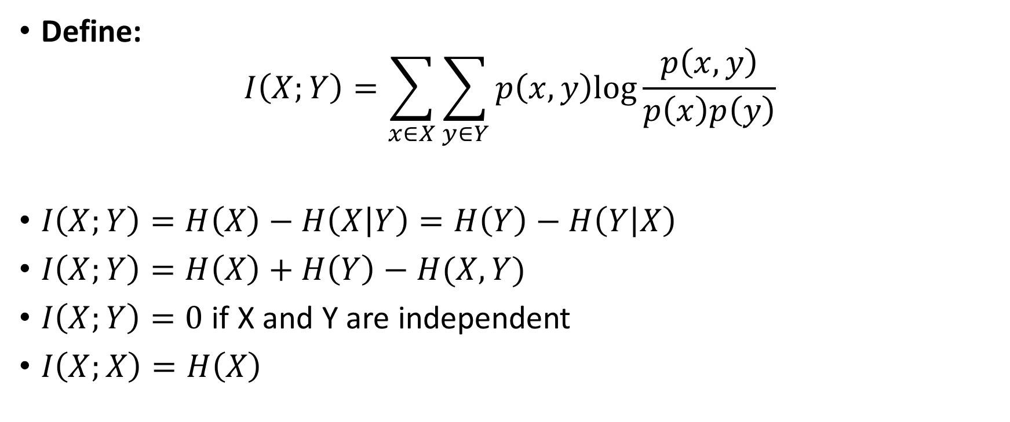
Mutual information(MI)
Define:
$$I\left(X;Y\right)=\sum_{x∈X}{\sum_{y∈Y}{p\left(x,y\right)log\frac{p\left(x,y\right)}{p\left(x\right)p\left(y\right)}}}$$
$I\left(X;Y\right)=H\left(X\right)−H\left(X | Y\right)=H\left(Y\right)−H\left(Y | X\right)$
$I\left(X;Y\right)=H\left(X\right)+H\left(Y\right)−H(X,Y)$
$I\left(X;Y\right)=0$ if X and Y are independent
$I\left(X;X\right)=H\left(X\right)$

Slide 6
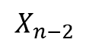
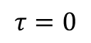

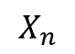
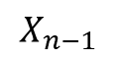
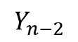
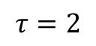

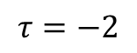
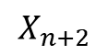
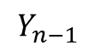
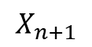
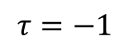
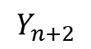
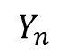
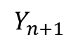
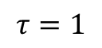
Time-delayed Mutual information(TDMI)
$$I\left(τ\right)=I\left(X(t);Y\left(t+τ\right)\right)=\sum_{x∈X\left(t\right)}{\sum_{y∈Y\left(t+τ\right)}{p\left(x,y\right)log\frac{p\left(x,y\right)}{p\left(x\right)p\left(y\right)}}}$$
For random series X and Y,
$$\left\{\begin{aligned}X_{i}=f(X_{i−1}, Y_{i−1}) \\ Y_{i}=g(X_{i−1}, Y_{i−1})\end{aligned}\right.$$
$$X_{n−2}$$
$$X_{n−1}$$
$$X_{n}$$
$$X_{n+1}$$
$$X_{n+2}$$
$$τ=−2$$
$$τ=−1$$
$$τ=0$$
$$τ=1$$
$$τ=2$$
$$Y_{n−2}$$
$$Y_{n−1}$$
$$Y_{n}$$
$$Y_{n+1}$$
$$Y_{n+2}$$

Slide 7
TDMI between spike trains
Spike trains generated by probabilistic model
Taghva, A., Song, D., Hampson, R. E., Deadwyler, S. A., & Berger, T. W. (2012).
Determination of Relevant Neuron–Neuron Connections for Neural Prosthetics Using Time-Delayed Mutual Information: Tutorial and Preliminary Results. World neurosurgery, 78(6), 618-630.

Slide 8
TDMI between spike trains
coding
Spike Train
Integer series
Calculating MI
Optimizing binning
Taghva, A., Song, D., Hampson, R. E., Deadwyler, S. A., & Berger, T. W. (2012).
Determination of Relevant Neuron–Neuron Connections for Neural Prosthetics Using Time-Delayed Mutual Information: Tutorial and Preliminary Results.

Slide 9
TDMI between EEG and sEMG
Jin, S. H., Lin, P., & Hallett, M. (2010).
Linear and nonlinear information flow based on time-delayed mutual information method and its application to corticomuscular interaction.

Slide 10
TDMI infers connectivity patterns
Endo, W., Santos, F. P., Simpson, D., Maciel, C. D., & Newland, P. L. (2015).
Delayed mutual information infers patterns of synaptic connectivity in a proprioceptive neural network.

Slide 11
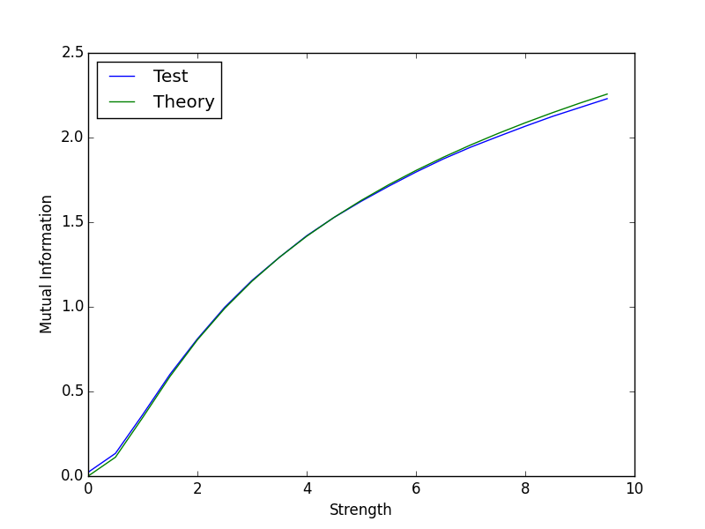
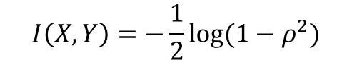
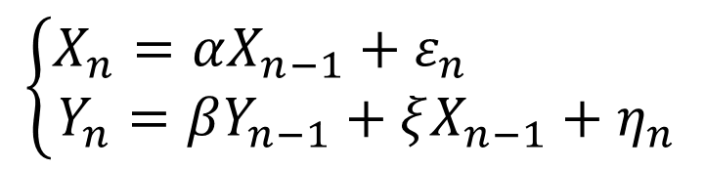
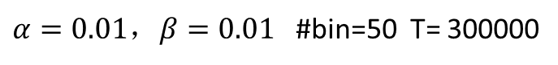
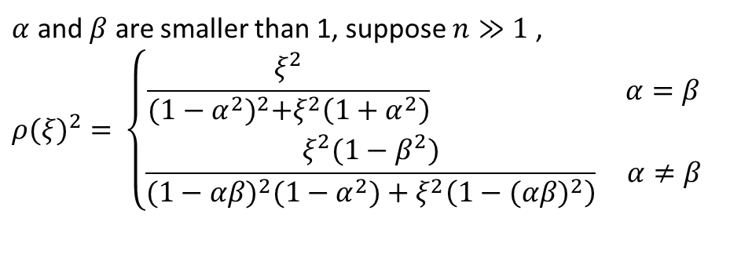
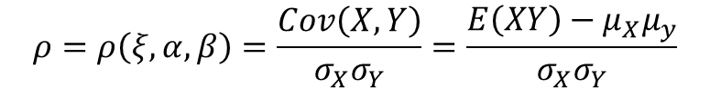
Mutual information of Gaussian random variables
$$\left\{\begin{aligned}X_{n}=αX_{n−1}+ε_{n} \\ Y_{n}=βY_{n−1}+ξX_{n−1}+η_{n}\end{aligned}\right.$$
$α=0.01，β=0.01$ #bin=50 T= 300000
$$I\left(X,Y\right)=−\frac{1}{2}log⁡(1−ρ^{2})$$
$$ρ=ρ\left(ξ,α,β\right)=\frac{Cov\left(X,Y\right)}{σ_{X}σ_{Y}}=\frac{E\left(XY\right)−μ_{X}μ_{y}}{σ_{X}σ_{Y}}$$
$α$ and $β$ are smaller than 1, suppose $n≫1$ ,
$${ρ(ξ)}^{2}=⁡\left\{\begin{aligned}\frac{ξ^{2}}{{(1−α^{2})}^{2}+ξ^{2}\left(1+α^{2}\right)} α=β \\ \frac{ξ^{2}(1−β^{2})}{{(1−αβ)}^{2}(1−α^{2})+ξ^{2}\left(1−{(αβ)}^{2}\right)} α≠β\end{aligned}\right.$$

Slide 12
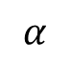
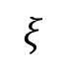
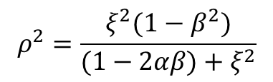
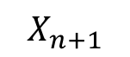
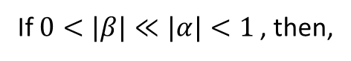
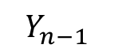
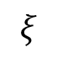
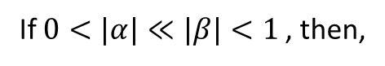
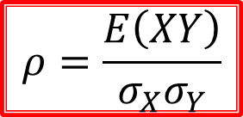
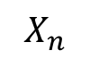
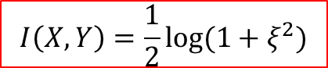
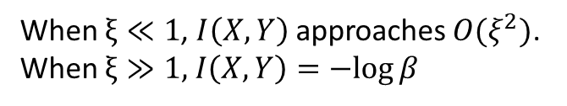
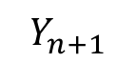
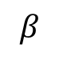
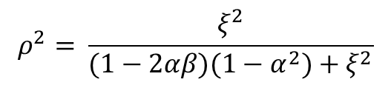
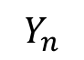
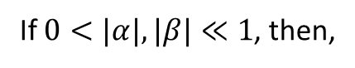
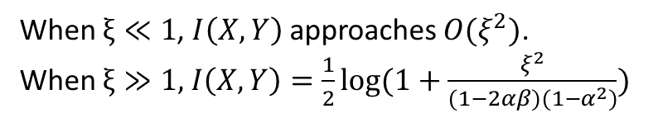
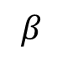
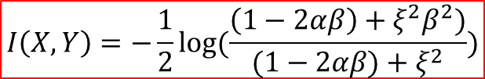
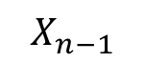
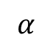
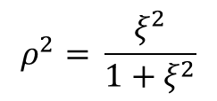
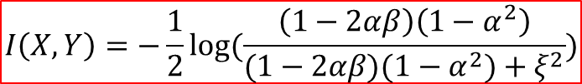
Mutual information of Gaussian random variables
$$ρ^{2}=\frac{ξ^{2}(1−β^{2})}{(1−2αβ)+ξ^{2}}$$
$$α$$
If $0<|α|≪|β|<1$, then,
$$α$$
$$X_{n−1}$$
$$X_{n}$$
$$X_{n+1}$$
$$I\left(X,Y\right)=−\frac{1}{2}log⁡(\frac{\left(1−2αβ\right)+ξ^{2}β^{2})}{(1−2αβ)+ξ^{2}})$$
$$ξ$$
$$ξ$$
When $ξ≪1$, $I\left(X,Y\right)$ approaches $O(ξ^{2})$.
When $ξ≫1,$ $I\left(X,Y\right)=−log⁡β$
$$β$$
$$β$$
$$Y_{n−1}$$
$$Y_{n}$$
$$Y_{n+1}$$
$$ρ^{2}=⁡\frac{ξ^{2}}{(1−2αβ)(1−α^{2})+ξ^{2}}$$
If $0<|β|≪|α|<1$, then,
$$ρ^{2}=⁡\frac{ξ^{2}}{1+ξ^{2}}$$
$$I\left(X,Y\right)=−\frac{1}{2}log⁡(\frac{\left(1−2αβ\right)\left(1−α^{2}\right)}{(1−2αβ)(1−α^{2})+ξ^{2}})$$
If $0<|α|, |β|≪1$, then,
$$I\left(X,Y\right)=\frac{1}{2}log⁡(1+ξ^{2})$$
When $ξ≪1$, $I\left(X,Y\right)$ approaches $O(ξ^{2})$.
When $ξ≫1,$ $I\left(X,Y\right)=\frac{1}{2}log⁡(1+\frac{ξ^{2}}{(1−2αβ)(1−α^{2})})$
$$ρ=\frac{E\left(XY\right)}{σ_{X}σ_{Y}}$$

Slide 13















Mutual information of Gaussian random variables
If $\left|α\right|,\left|β\right|<1$, then,
$$α$$
$$I(X,Y)=⁡\left\{\begin{aligned}−\frac{1}{2}log⁡(\frac{{\left(1−α^{2}\right)}^{2}+ξ^{2}α^{2}}{{\left(1−α^{2}\right)}^{2}+ξ^{2}\left(1+α^{2}\right)}) α=β \\ −\frac{1}{2}log(\frac{{\left(1−αβ\right)}^{2}\left(1−α^{2}\right)+ξ^{2}β^{2}\left(1−α^{2}\right)}{{\left(1−αβ\right)}^{2}\left(1−α^{2}\right)+ξ^{2}\left(1−{\left(αβ\right)}^{2}\right)}) α≠β\end{aligned}\right.$$
$$α$$
$$X_{n−1}$$
$$X_{n}$$
$$X_{n+1}$$
$$ξ$$
$$ξ$$
$$β$$
$$β$$
When $ξ≪1$, $I\left(X,Y\right)$ approaches $O(ξ^{2})$.
When $ξ≫1,I(X,Y)=⁡\left\{\begin{aligned}−\frac{1}{2}log⁡(\frac{α^{2}}{1+α^{2}}) α=β \\ −\frac{1}{2}log(\frac{β^{2}\left(1−α^{2}\right)}{1−{\left(αβ\right)}^{2}}) α≠β\end{aligned}\right.$
$$Y_{n−1}$$
$$Y_{n}$$
$$Y_{n+1}$$
$$ρ=\frac{E\left(XY\right)}{σ_{X}σ_{Y}}$$

Slide 14








$α=0.01，β=0.01$ #bin=150 T= 300000
$α=0.01，β=0.6$ #bin=50 T= 300000
$α=0.6，β=0.01$ #bin=150 T= 300000
$α=0.5，β=0.6$ #bin=50 T= 300000

Slide 15






$α=0.01，β=0.01$ #bin=50 T= 300000
$α=0.01，β=0.01$ #bin=150 T= 300000
$α=0.6，β=0.01$ #bin=50 T= 300000
$α=0.6，β=0.01$ #bin=150 T= 300000

Slide 16




#trials = 300000
#trials = 1500000
#bins = 10
#bins = 50

Slide 17







1k trials
10k trials
100k trials
$$α=β=0.5, ξ=1, \#bins=10$$
20 bins
25 bins
50 bins

Slide 18



$$Baseline ∝\frac{1}{Length of data set}$$
#trials = 100 k
#bins = 10
Notes:
40

Slide 19











TDMI between spike train and local field potential(LFP)
Conductance-based Integrate-and-fire model:
Spike Train
dt
$$C\frac{dv}{dt}=−g_{l}\left(v−ε_{l}\right)−g_{Q}\left(v−ε_{Q}\right)$$
0 0 0 0 1 0 0 0 1 0 0 0 0 1 0 1
X
$$Q∈\left\{e,i\right\}$$
Local Field Potential
$$g_{Q}=S_{Q}\sum_{j, t≥t_{j}}{exp⁡(−\frac{t−t_{j}}{τ_{Q}})}$$
$$I_{t_{1}}, I_{t_{2}},I_{t_{3}},I_{t_{4}},I_{t_{5}},I_{t_{6}},…,I_{t_{n}}$$
Y
When $v\left(t=t_{i}\right)≥v_{θ},$
$$v\left(t\right)=v_{r} , v∈[t_{i}, t_{i}+τ_{ref})$$
$$I\left(X;Y, τ\right)=\sum_{x∈X}{\sum_{y∈Y(τ)}{p\left(x,y\right)log\frac{p\left(x,y\right)}{p\left(x\right)p\left(y\right)}}}$$
‘Point source’ current model of local field potential:
$$I_{real}≅I_{obs}+\frac{B_{X}+B_{Y}−B_{XY}−1}{2N}$$
$$V=\frac{1}{4πσ}\sum_{i}{\frac{I_{i}}{r_{0}−r_{i}}}$$
$$I=−g_{l}\left(v−ε_{l}\right)−g_{Q}\left(v−ε_{Q}\right)$$
$$Q∈\left\{e,i\right\}$$
Roulston, M. S. (1999).
Estimating the errors on measured entropy and mutual information.
Notes:
讲一下参数

Slide 20











TDMI Estimation
$$I\left(X;Y, τ\right)=\sum_{x∈X}{\sum_{y∈Y(τ)}{p\left(x,y\right)log\frac{p\left(x,y\right)}{p\left(x\right)p\left(y\right)}}}$$
$p\left(x,y\right)$ estimation
$$X\left(t\right)= {\{X}_{t_{1}}, X_{t_{2}},…,X_{t_{n}}\}$$
$$I\left(X;Y,τ\right)$$
Treated time series of LFP as WSS signal.
Neglect the autocovariance length of LFP.
$$P\left(X\right)$$
$X′= {\{X}_{t^{1}}, X_{t^{2}},…,X_{t^{m}}\}$, $m<n$
$X_{t^{i}}= {\{X}_{t_{i}}, X_{t_{i+m}},…,X_{t_{i+km}}\}$
$$I\left(X_{t^{i}};Y_{t^{i+τ}}\right)$$
$$P\left(X_{t^{i}}\right)$$
$$Remark: p\left(x,y\right)$$
Uniform partition
Adaptive partition
Y
Y
$O_{XY}\left(i,j\right)$=Const
X
X

Slide 21
Paradigm of simulation
Poisson Driving
Poisson Driving
Conductance
Neuron 1
Spikes
Conductance
Neuron 2
Spikes
Synaptic Current
Synaptic Current

Slide 22

Sample Figure
The peak lying on the positive side of the graph indicates the same direction of neuronal information as the physical connection does.
dt | 0.5 ms
#bins | 10
Poisson Rate | 1.3kHz
Forward Strength | 0.005
Synaptic Strength | 0.005
T | 200 s

Slide 23






#bins=10
Length of time series
1k ms
10k ms
100k ms
100k ms
#bins=20
#bins=30
#bins=40

Slide 24



#bins = 10
Length of time series = 600 s

Slide 25

One-way Connection
Poisson Rate | 1.3 kHz | dt | 0.5 ms
S | 0.005 | #bins | 10
F | 0.005 | T | 200 s
From 1 to 2
From 2 to 1

Slide 26
Neuronal Interaction layout
spike 1
spike 2
？
1
2
current 1
current 2

Slide 27



I(spike, voltage)
I(spike, current)
I(spike, conductance)

Slide 28



TDMI between spike and its own current, voltage and conductance respectively
I(spike, current)
I(spike, voltage)
I(spike, conductance)

Slide 29



STA(voltage)
STA(current)
STA(conductance)

Slide 30
Neuronal Interaction layout
spike 1
spike 2
current 1
spike 1
current 2
spike 2
current 1
current 2

Slide 31
Neuronal Interaction layout
current 1
current 1
spike 1
spike 1
current 2
current 2
spike 2
spike 2
2 ms

Slide 32



Poisson Rate | 1.3 kHz | dt / d$τ$ | 0.5 ms | Delay | 2 ms
Poisson S | 0.005 | #bins | 10 | Firing Rate | 14 Hz
Synaptic S | 0.005 | T | 10mins | #data points | 1199000
Spike 1 to Current 2
Spike 2 to Current 1

Slide 33














Mutual information calculation with different shifting scheme
$$S_{n−1}$$
$$S_{n}$$
$$S_{n+1}$$
$$S_{n}$$
$$τ<0$$
$$τ<0$$
$$τ=0$$
$$τ=0$$
$$τ>0$$
$$τ<0$$
$$I_{n}$$
$$I_{n−1}$$
$$I_{n}$$
$$I_{n+1}$$
Shifting spike train
Shifting current

Slide 34





Shifting spike train
Shifting current
Mutual information calculation
with different shifting scheme
Poisson Rate | 1.3 kHz
Poisson S | 0.005
Synaptic S | 0.005
dt / d$τ$ | 0.5 ms
#bins | 10
T | 50mins
Delay | 0 ms
Firing Rate | 14 Hz
#data points | 75k

Slide 35



Mutual information calculation
with different shifting scheme
Shifting spike train
Shifting current
Poisson Rate | 1.3 kHz
Poisson S | 0.005
Synaptic S | 0.005
dt / d$τ$ | 0.5 ms
#bins | 10
T | 4.4h
Delay | 0 ms
Firing Rate | 14 Hz
#data points | 400k

Slide 36


Bi-directed Connection
Poisson Rate | 1.5 kHz | dt | 0.5 ms
S | 0.005 | #bins | 20
F | 0.005 | T | 600 s
From 1 to 2
From 2 to 1

Slide 37







Triple-neuron system
1to2
2to3
1to3
2to1
3to2
3to1
Poisson Rate | 1.5 kHz
S | 0.005
F | 0.005
#bins | 20
T | 5 mins

Slide 38


Slide 39
Summary
Concepts of self-information, entropy and mutual information
TDMI between spike-spike interaction, EEG-sEMG correlation, and its inference of neuronal connecting pattern
TDMI between Gaussian random variables
TDMI between spike train and local field potential

Slide 40
Thanks for your attention

Slide 41



Robustness
Fix the product of Poisson driving rate and feedforward strength. Change the Poisson driving rate and investigate the change of mutual information pattern
1.5 kHz
0.15 kHz
0.1 kHz
dt | 0.5 ms
#bins | 20
T | 10 mins
Synaptic Strength | 0.005

Slide 42




Direct calculation
Relation between synaptic strength and values of maximum mutual information
Synaptic strength ranging from 0.001 to 0.0145
Mean firing rate for presynaptic neuron is 25.5 Hz
Mean firing rate for postsynaptic neuron is ranging from 25.32 Hz to 28.06 Hz
dt | 0.5 ms
#bins | 10
T | 5 mins
$$MI=As^{2}$$

Slide 43


Shifting spike train
Shifting current

Slide 44




TDMI between spike train and LFP
Cross network
Within network
Connected
#neuron(pre) | 1 | #neuron(post) | 100
Poisson Rate | 1.3 kHz | Con Density | 20%
S | 0.005 | Con Prob | 0.5 | dt | 0.5 ms
F | 0.005 | T | 600 s | #bins | 10
Within network
Disconnected

